Slide 1

M5 – Visual Recognition
Project: Cross-modal Retrieval
Week 3: Challenges of Object Detection and Segmentation
​
Group 3: Guillem Capellera, Abel García, Johnny Nuñez and Anna Oliveras
Notes:
My name is
What?
My name is
Who?
My name is
Chika-chika
Slim Shady

Slide 2
Tasks
Week 3
a. Detection and segmentation in Out-of-Context Dataset.
b. Detection in MSCOCO Dataset by transplanting new objects by co-occurrence.
c. Detection in MSCOCO Dataset by qualitatively Transplant.
d. Detection in MSCOCO Dataset by Feature interference.
e. Style transfer (optional)
f. Start writing paper: Methodology and Experiments

Slide 3
Task a: Detection and segmentation in Out-of-Context Dataset.

Slide 4

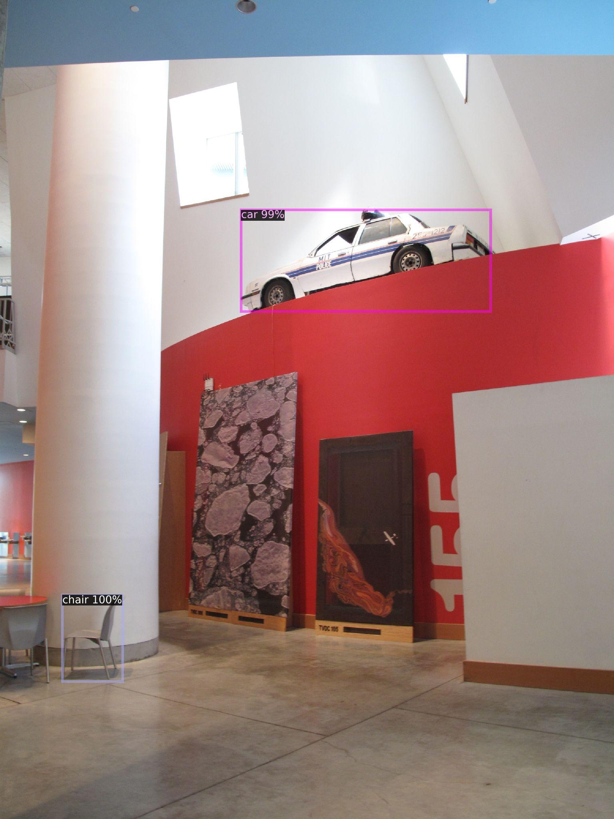
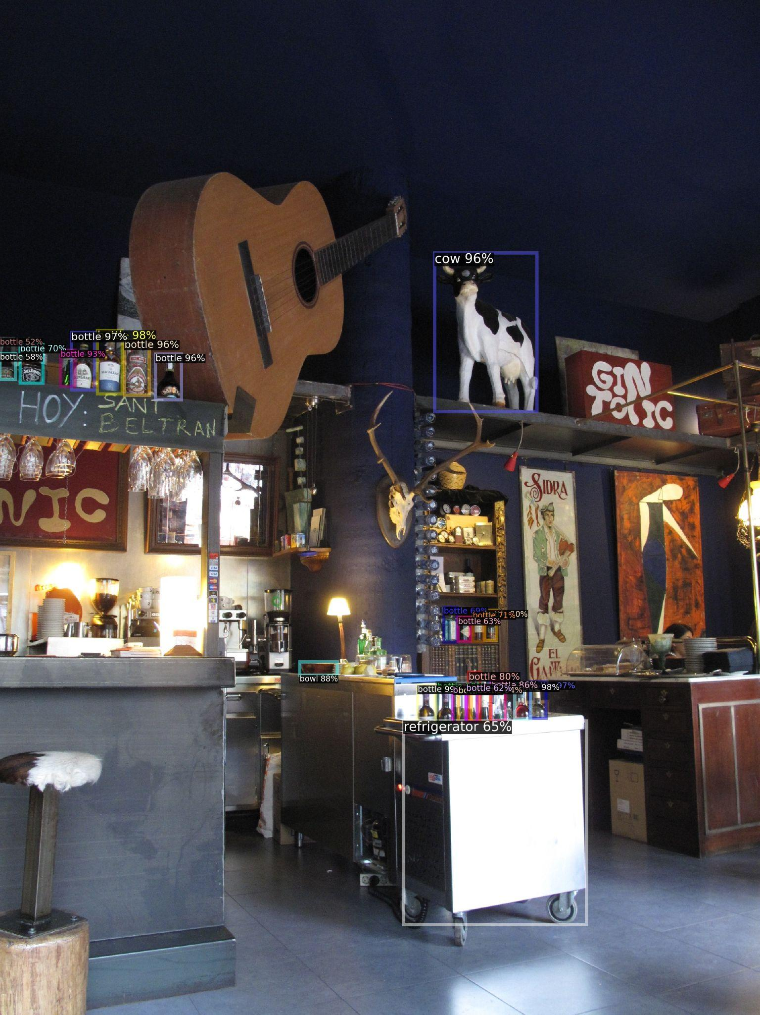
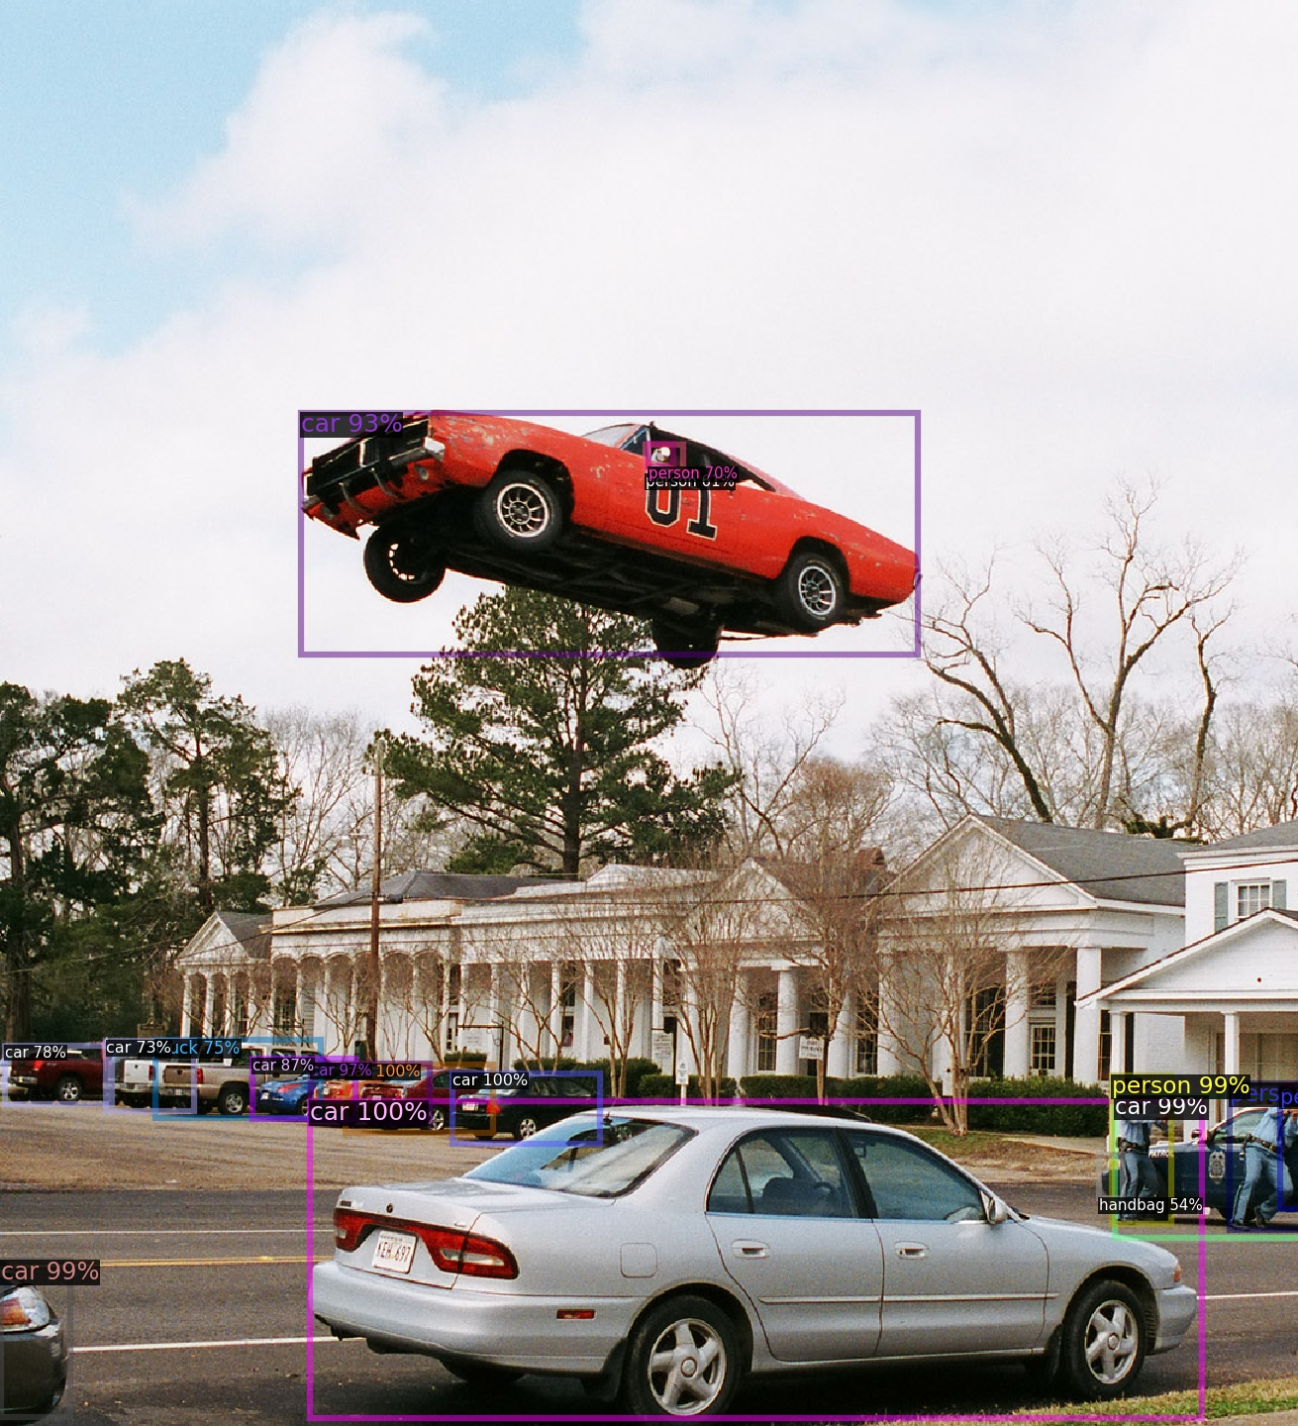
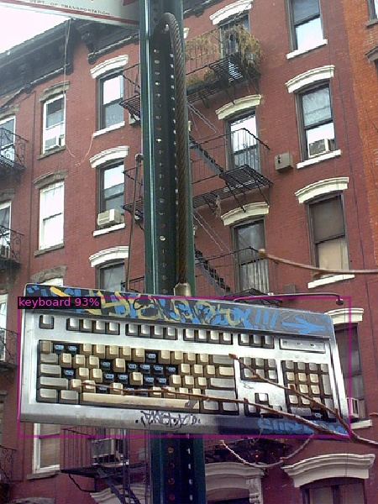
Task (a): FasterRCNN: Good examples
Good examples → FasterRCNN is still able to correctly detect and label objects that are out of context

Slide 5
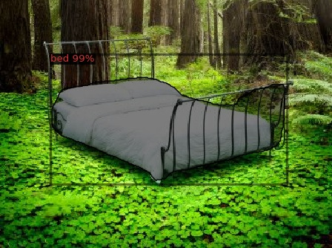
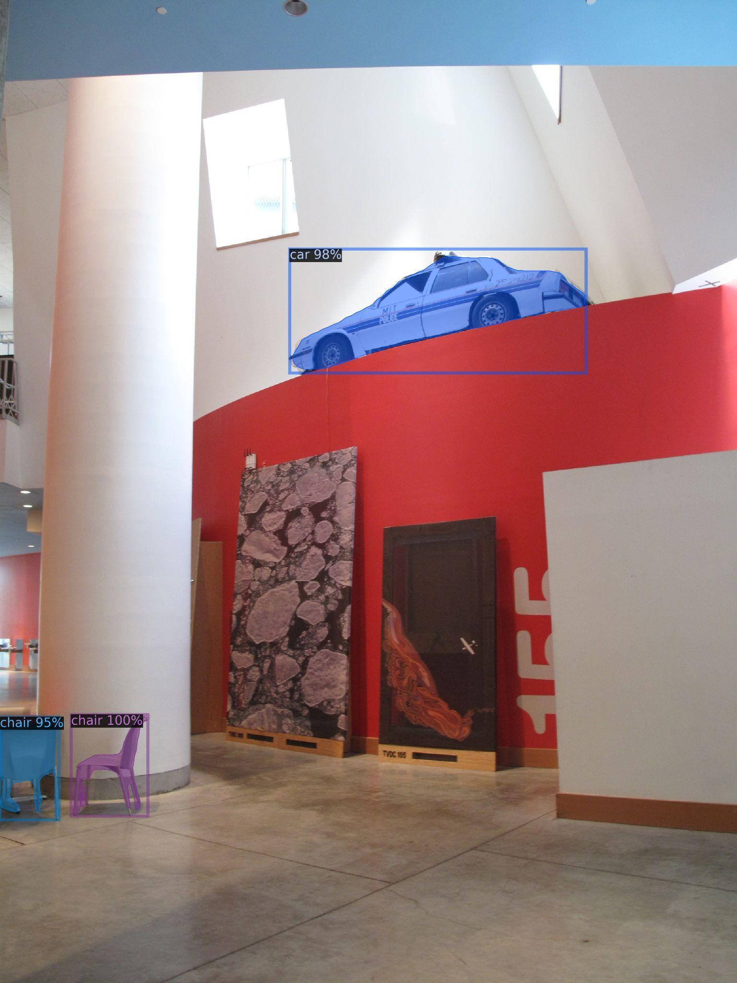
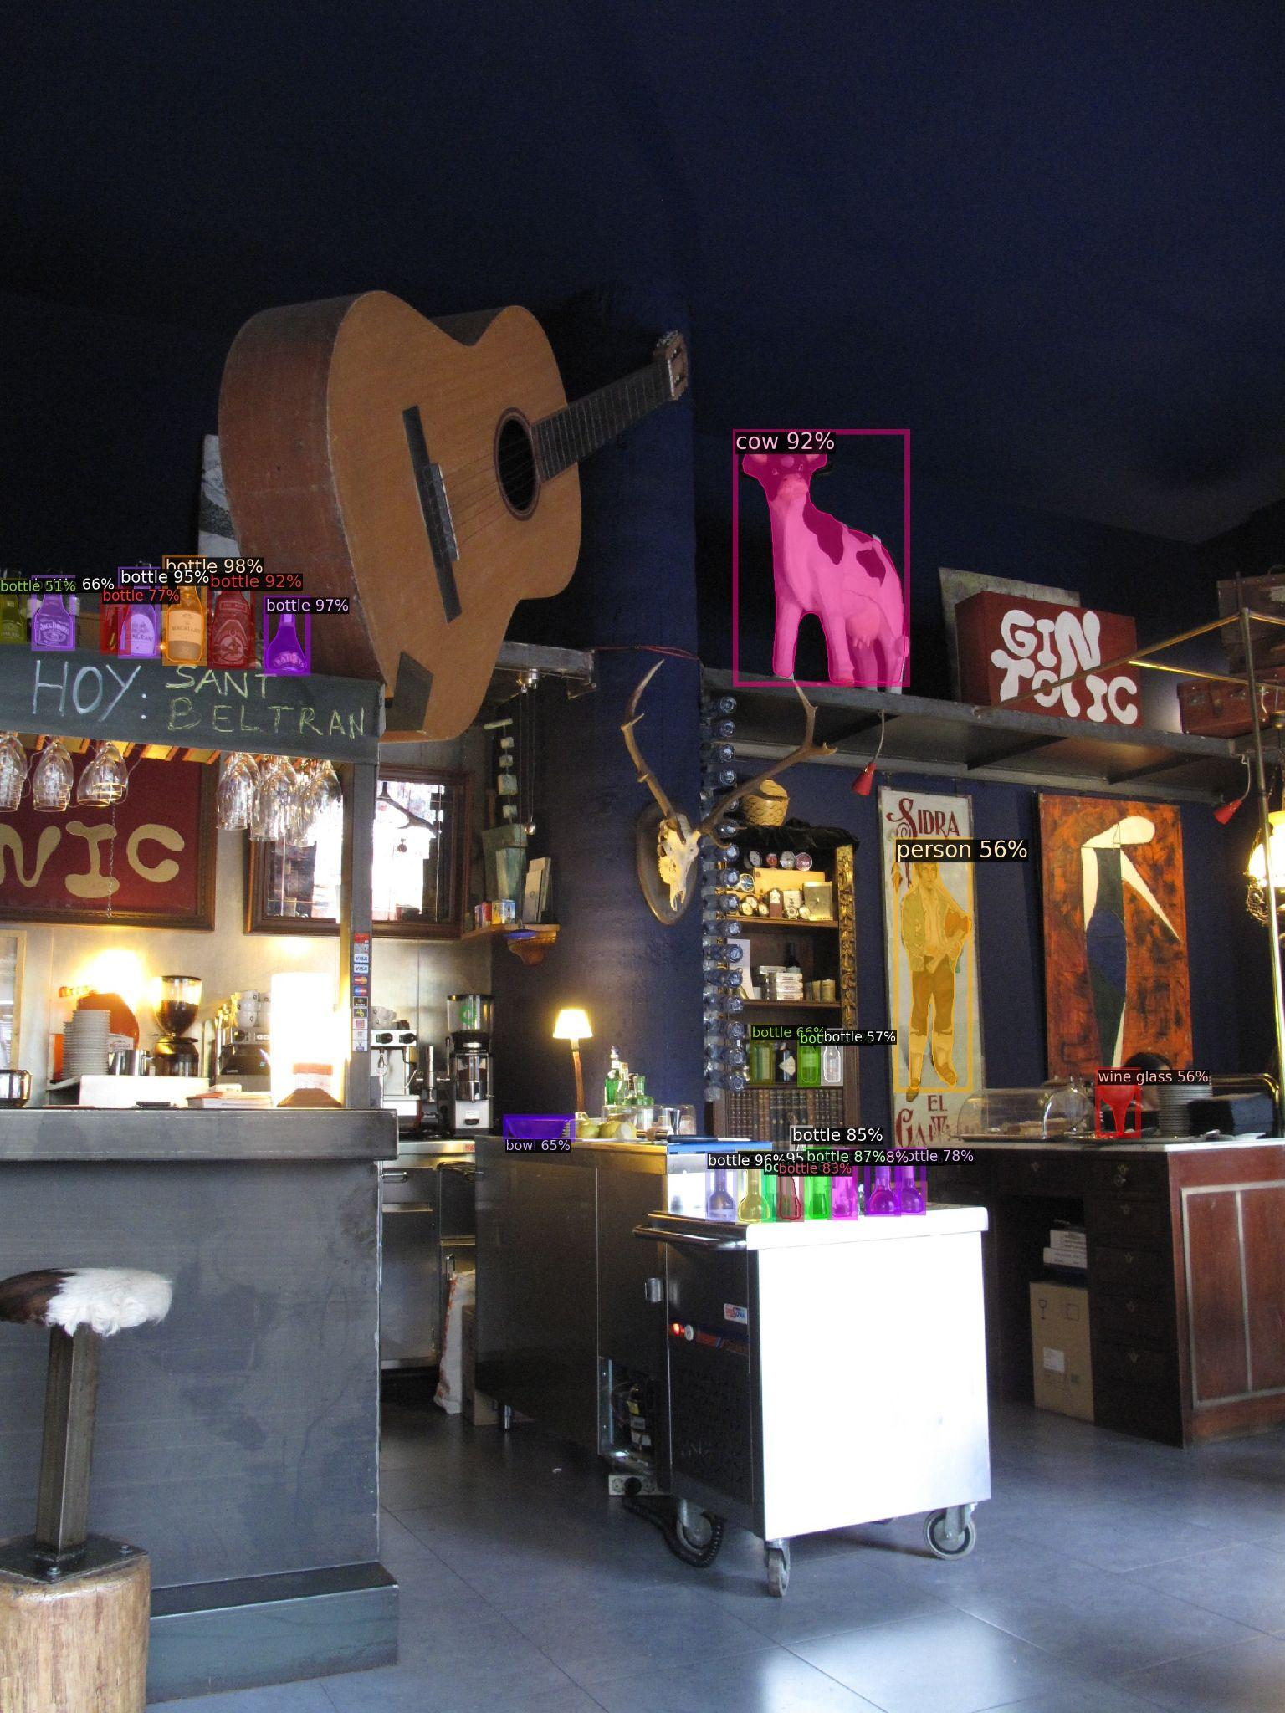
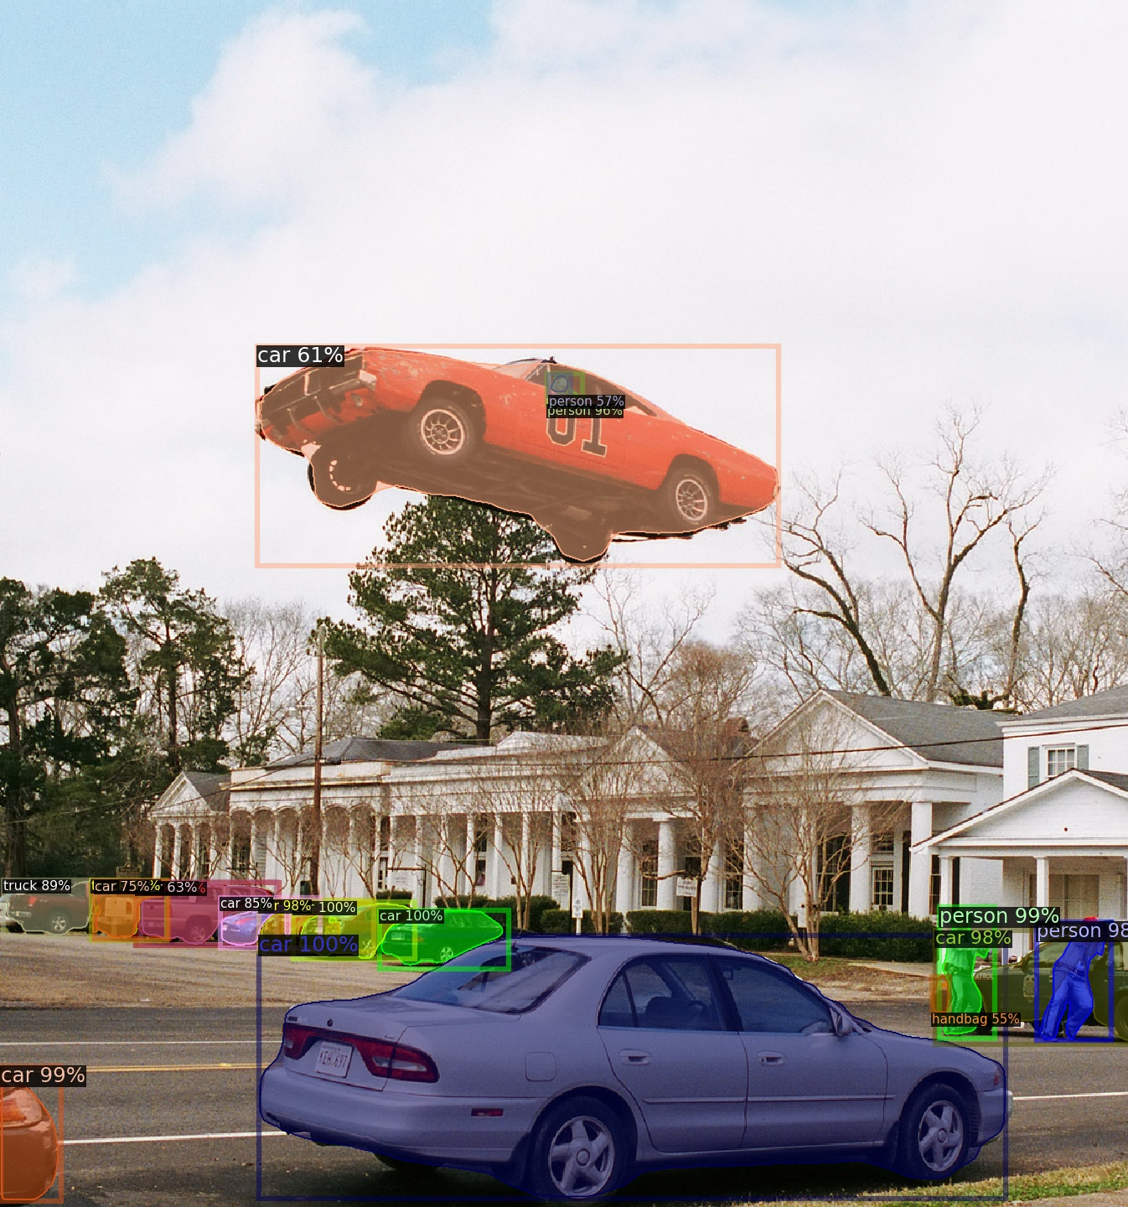
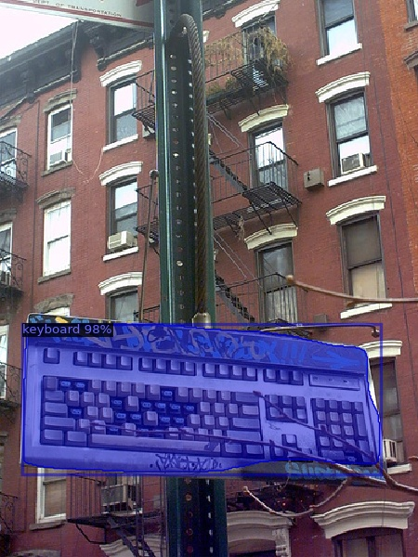
Task (a): MaskRCNN: Good examples
Good examples → MaskRCNN, similarly to FasterRCNN is still able to correctly detect and label objects outside its context, with slightly higher confidence values.

Slide 6
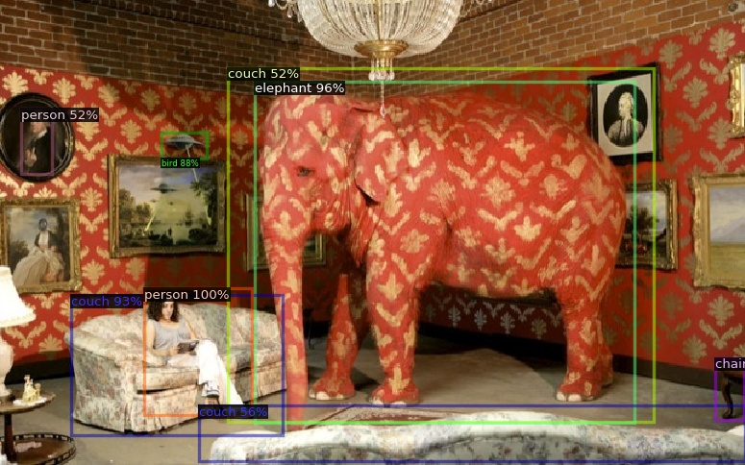
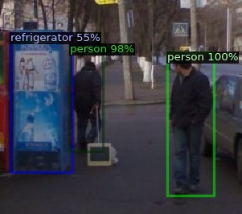
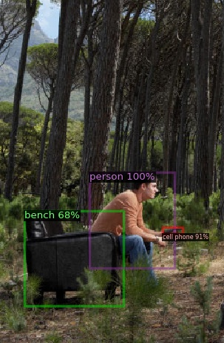
Task (a): FasterRCNN: Bad examples
Bad examples → FasterRCNN fails when the texture of the object is different, but not for the context itself, as it happens as the elephant of the first image, that has a texture similar to a couch. It detects the elephant because of its shape, but it also detects a couch in the same region of the image.
The vending machine of the center image is confused as a refrigerator, but from the point of view of the camera they are similar. Again, it seems that the problem is not that the objects are outside of its context.
Also, in the right image the couch is incorrectly labeled as a bench, in this case indeed probably to the context, since a couch is usually inside a building, and a bench outdoors.

Slide 7
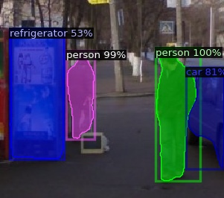
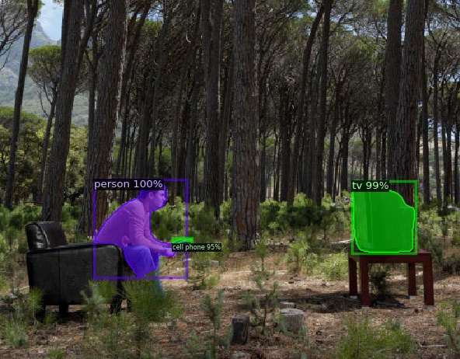
Task (a): MaskRCNN: Bad examples
Bad examples → MaskRCNN fails in less cases than FasterRCNN. However, it still miss predicts the vending machine as a refrigerator. And in the right image, it is not able to detect the couch.

Slide 8
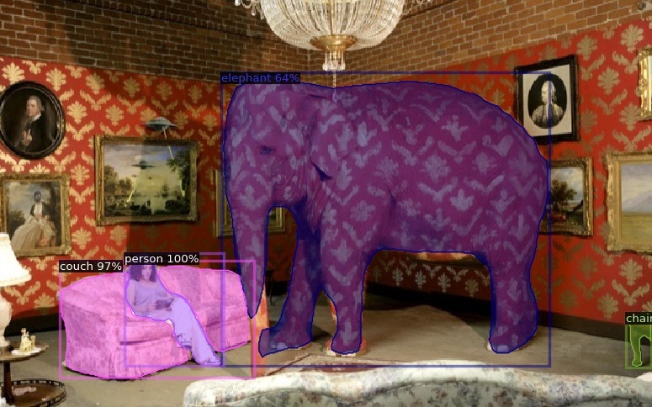
Task (a): Out-of-Context Dataset
FasterRCNN MaskRCNN
FasterRCNN detects the elephant but also a couch in the same region of the image, but MaskRCNN detects just the elephant in that region.
FasterRCNN also fails in detecting a false bird above one painting, and a person painted on another painting. MaskRCNN does not fails since it does not detect those 2 incorrect objects.

Slide 9
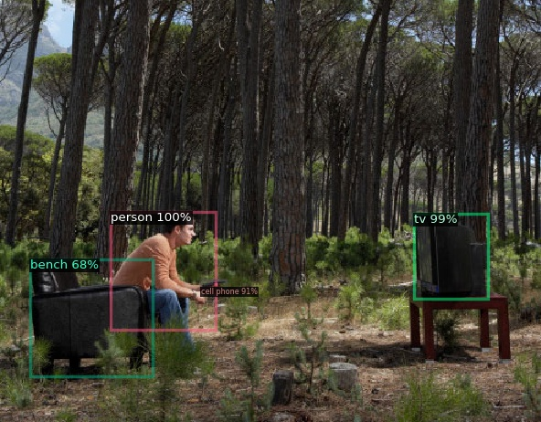
Task (a): Out-of-Context Dataset
FasterRCNN MaskRCNN
FasterRCNN incorrectly labels a couch as a bench probably due to the fact that it is outdoors and not inside a building. However, in this case MaskRCNN directly is not able to recognize any object in that region. Again probably due to the context and the similar colours of the couch to the trees.

Slide 10
Task (a): Out-of-Context Dataset
FasterRCNN MaskRCNN
In this case both networks incorrectly label the vending machine as a refrigerator. However, in this case it seems because of the similar appearance that this object has to a refrigerator, independently of the context.
Mask-RCNN is able to detect the car that is behind the pedestrian.

Slide 11
Task (a): Summary
FasterRCNN fails when the texture of the object in the dataset is different from the object in the real world. For example, in the case of the elephant that has a texture similar to a couch, and FasterRCNN misclassifies it indeed as a couch. That is something that does not happen with MaskRCNN.
For some objects that have similar texture and color than the background, and are outside its context, FasterRCNN tends to missclasify them, while MaskRCNN tends to directly not detect them.
However, overall, both MaskRCNN and FasterRCNN are still able to correctly detect and label objects outside its context in almost all cases.

Slide 12
Task b: Detection in MSCOCO Dataset by transplanting new objects by co-occurrence

Slide 13
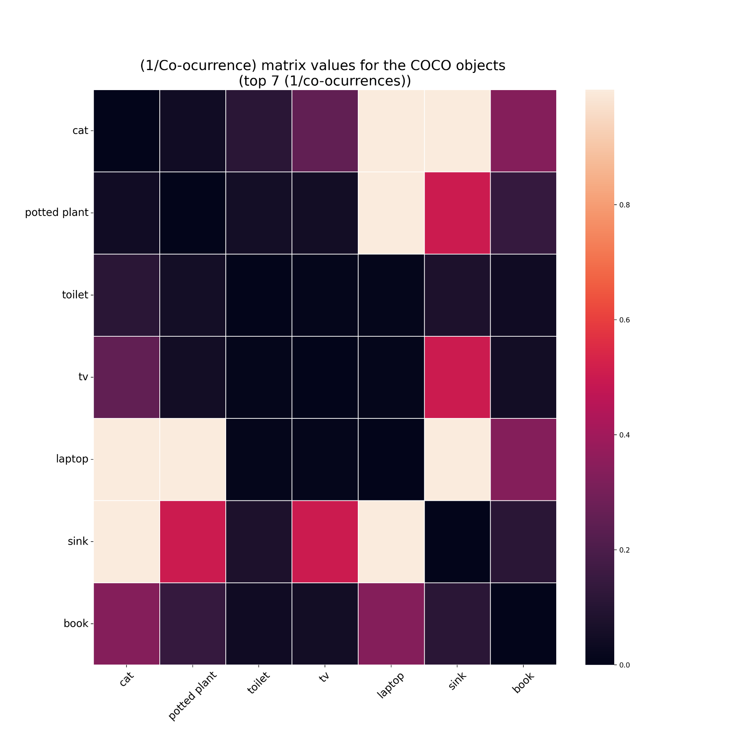
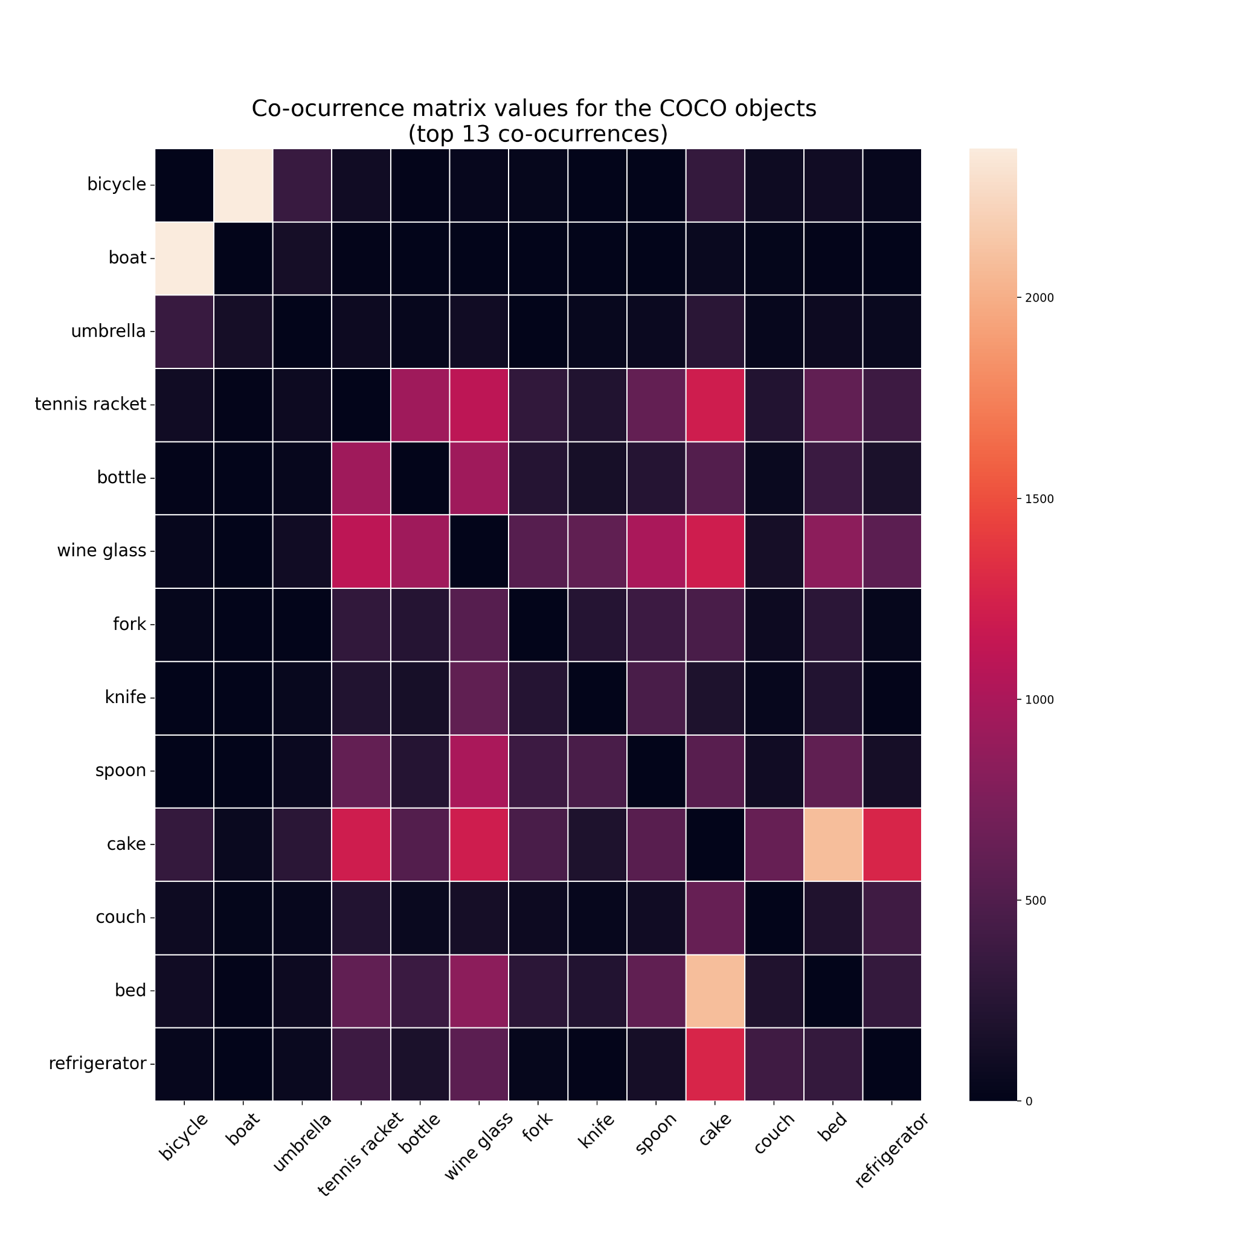
Task (b): Transplanting new objects by co-occurrence
We want to pick 2 pairs of random images to transplant objects from one image to the other. However, to do it smartly, we will transplant objects with less co-ocurrence, to make it difficult for the network.
Therefore, we compute the co-ocurrence matrix of all the COCO classes.
First of all, we display here just the top with higher (1/co-ocurrence), since all the classes are too much for a nice visualization.
We also display here the objects with highest co-ocurrence for curiosity:

Slide 14
Task (b): Transplanting new objects by co-occurrence
Methodology:
We use the objects with higher (1/co-ocurrence).
We take one image I of test subset that has one of those classes, and one image J of the val subset that also has one of those classes, and then we transplant one of those objects from Image J into image I in a random position.
Then we evaluate the object detection in the modified image I.
Note that all the process is automatic.

Slide 15
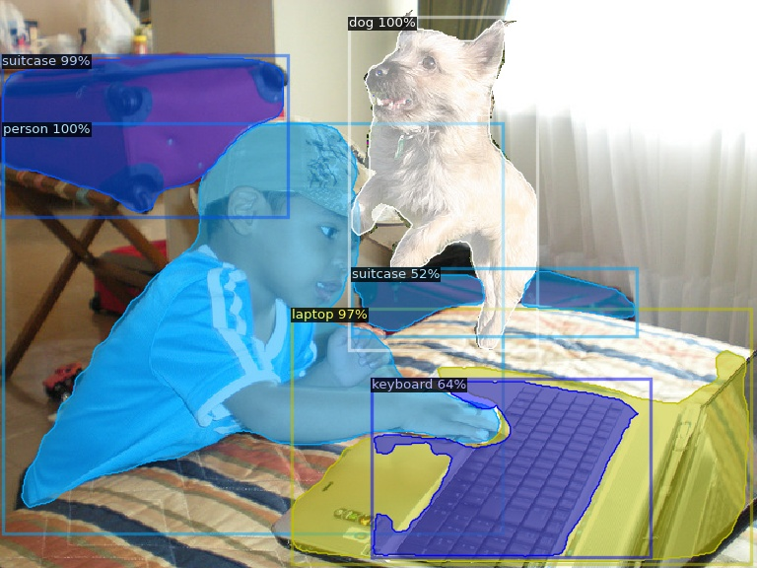
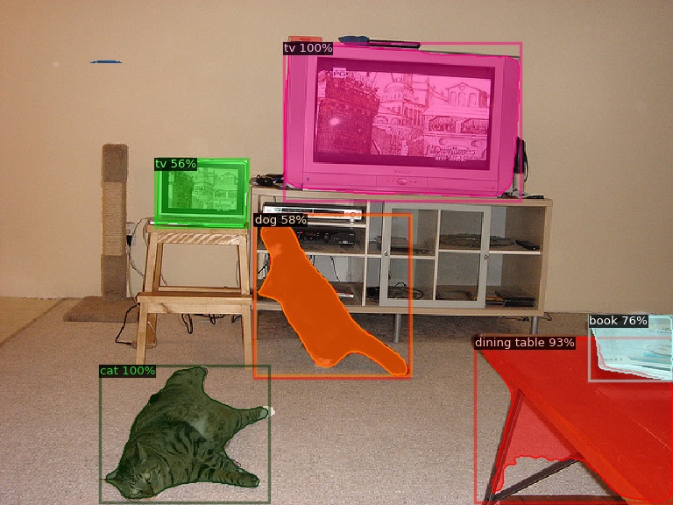
Task (b): Transplanting dogs
In all the cases we analyzed, the Mask-RCNN is still able to correctly recognize the transplanted dogs.

Slide 16
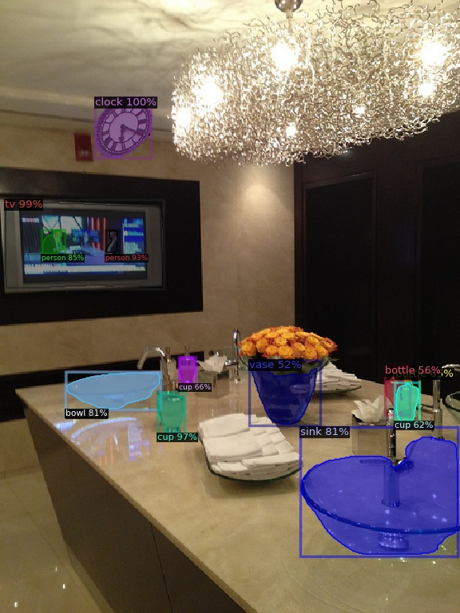
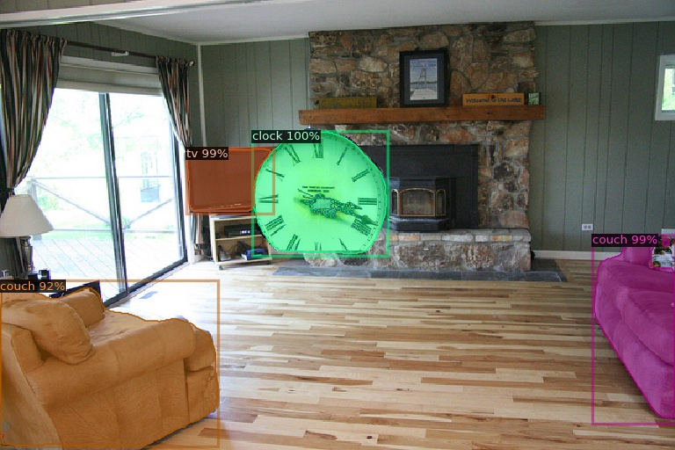
Task (b): Transplanting clocks
In all the cases the Mask-RCNN is still able to correctly recognize the transplanted clocks.

Slide 17
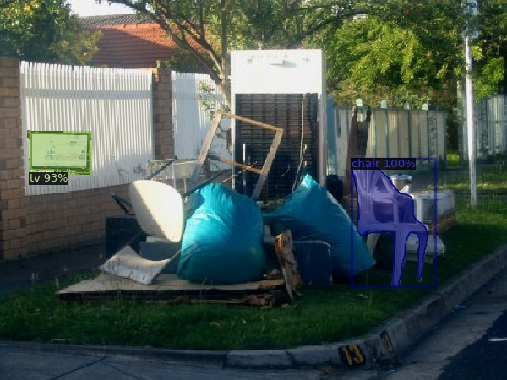
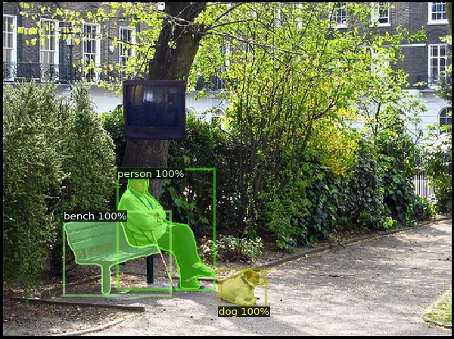
Task (b): Transplanting a TV
Mask RCNN sometimes fails to recognize the TV. Note that in this case it may be because of the placement of the tv, since the surroundings have a similar color (image on the right).

Slide 18
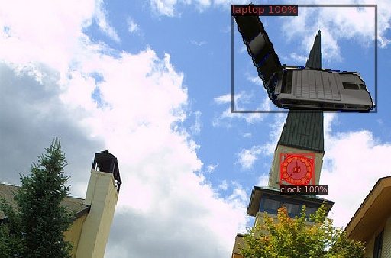
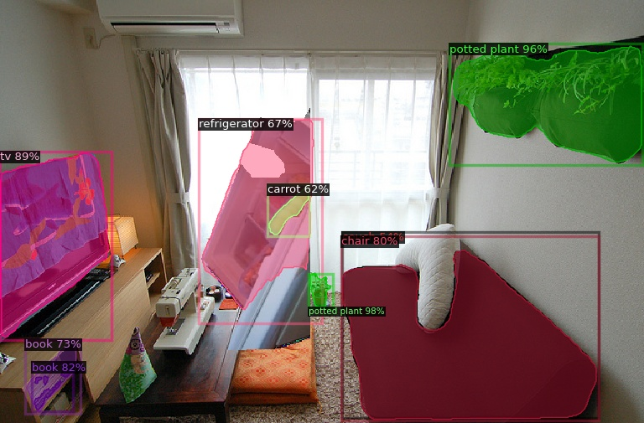
Task (b): Transplanting a laptop
Some other objects like laptops and potted plants are always still recognized:

Slide 19
Task (b): Summary
We compute the (1/co-ocurrence) matrix of the objects that appear in the validation subset groundtruth.
We transplant the least co-ocurrenced objects into other random images that also have those objects, at a random position.
We evaluate the object detection in the new modified image using Mask-RCNN.
In all the cases we analyzed, Mask-RCNN is still able to correctly recognize the transplanted objects. Specially for the case of the dogs and the clocks.
However, in a few cases it fails in recognizing the TVs. It does not missclasify them, it just do not detect them. It happens specially when the background is dark, like the TV color.
Notes:
Task a:
Object detection models such as FasterRCNN and MaskRCNN can struggle with object recognition when textures are similar or when objects are outside their context. FasterRCNN can misclassify objects with similar textures, while MaskRCNN can more accurately detect such objects. However, both models can still correctly detect and label objects outside their context in most cases.
Task b:
When transplanting objects into new images using MaskRCNN, the model is generally able to recognize the transplanted objects, especially for cases such as dogs and clocks. However, in some cases, such as TVs in dark backgrounds, the model may fail to detect the objects. This highlights the importance of background and lighting conditions for object detection.
Task c:
The background of an image plays a critical role in object detection accuracy, and overlapping or partially occluded objects can be challenging for the model. Duplicating objects in an image can provide additional information that can help the model detect and classify objects more accurately, especially if the duplicated object is in a different location or under different lighting conditions than the original object.
Task d:
Feature interference can be harmful to the detection process in MaskRCNN, as features obtained from pixels outside the region of interest can interfere with the predictions. Adding random noise can further amplify this issue. Therefore, it is essential to pay attention to the pixels and features included in the model's training and detection processes.
Task e:
Style transfer can impact object detectability, as some styles may result in texture loss and non-uniform contours, making it more difficult for object detection models to identify objects. It is important to choose styles that preserve object details and contours to minimize the impact on object detection accuracy.

Slide 20
Task c: Qualitative analysis of transplanting an existing object

Slide 21
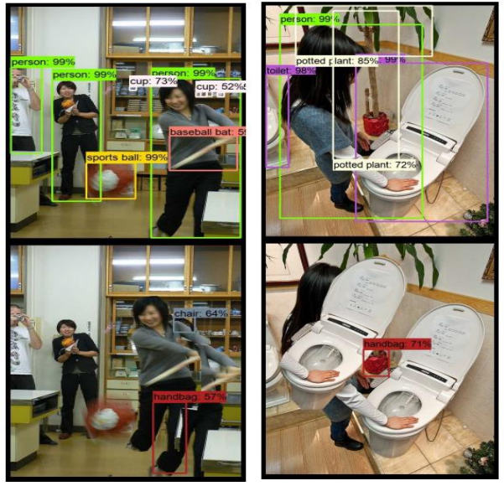
Task (c): Qualitatively Transplant
Goal: examine the impact of transplanting an object within the same image on the detection of the duplicated object and surrounding objects
Model used: Mask R-CNN 101 FPN
Images: selected randomly from the COCO’s 2017 dataset.
This section is divided in four main issues that we have encountered during the analysis:
Background matters
Overlaps
Partial occlusions
“Crowded”
[1] Rosenfeld, A., Zemel, R., & Tsotsos, J. K. (2018). The Elephant in the Room. arXiv preprint arXiv:1808.03305.

Slide 22
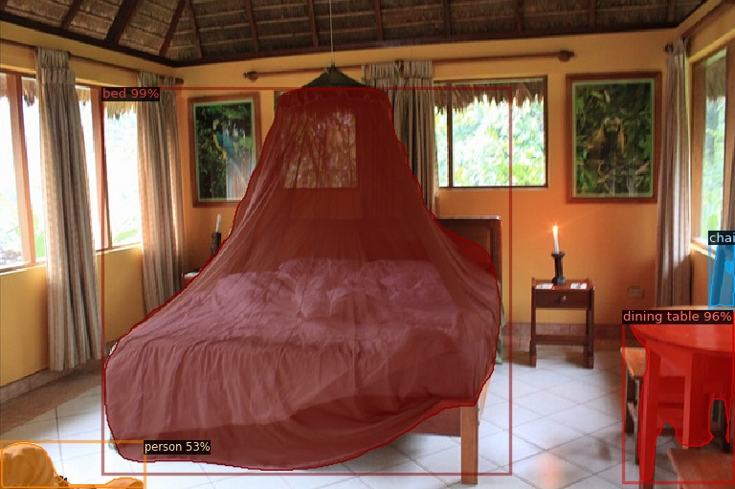
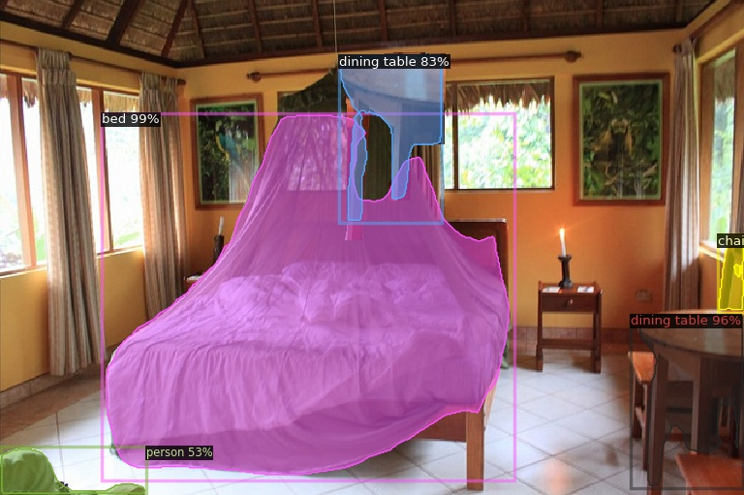
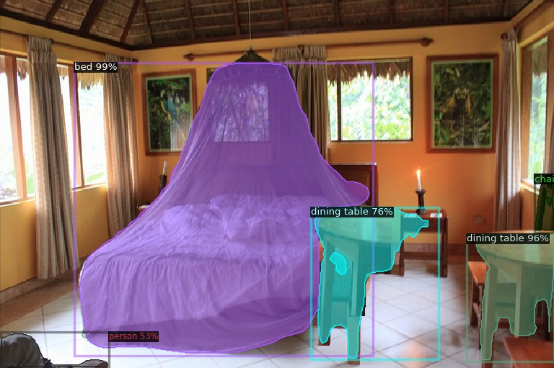
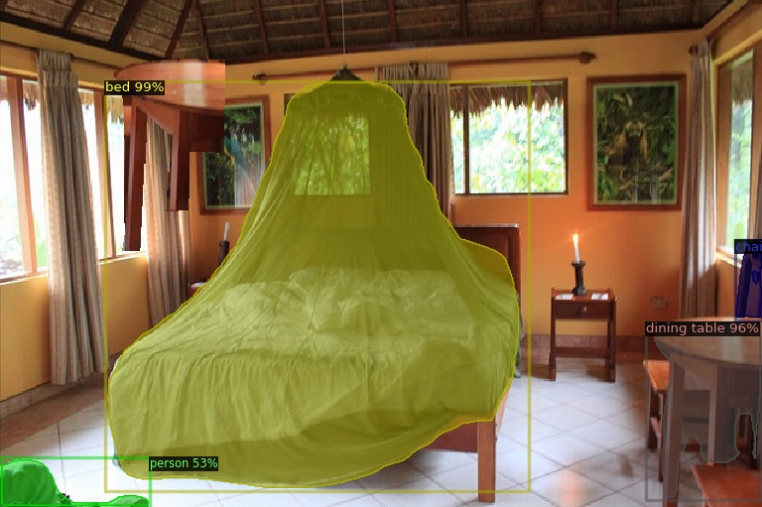
Task (c): Background matters: similar color
Dining table
Good
Good
The performance of the object detection heavily depends on the features present in the image. If an object is located in a region with a similar color background, the model may not detect it as accurately or may misclassify it.
No detection
This can happen because the model focuses on the features of the object, and if the background is too similar, it might be difficult to distinguish the object from the background.

Slide 23
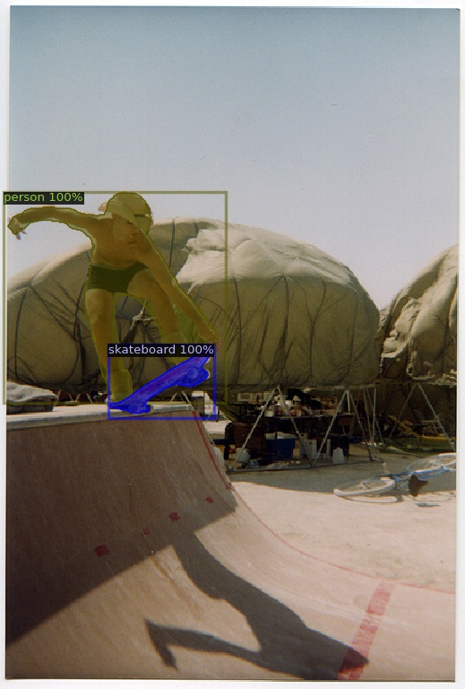
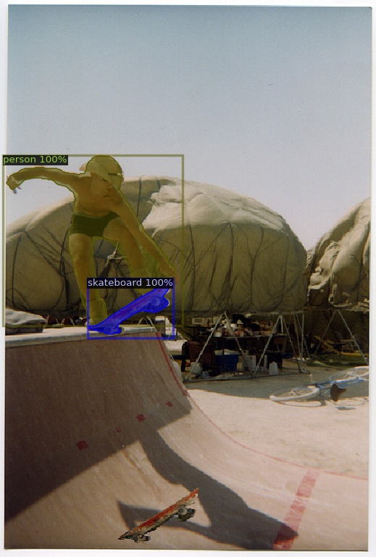
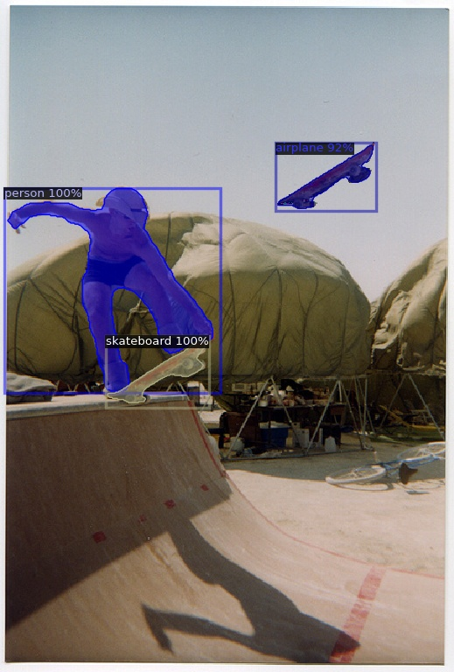
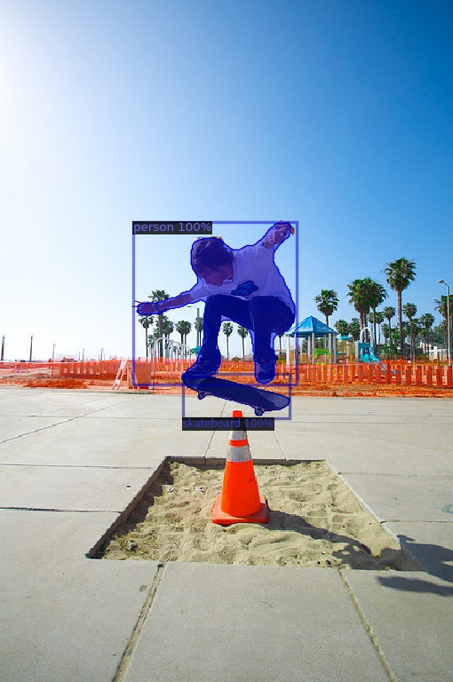
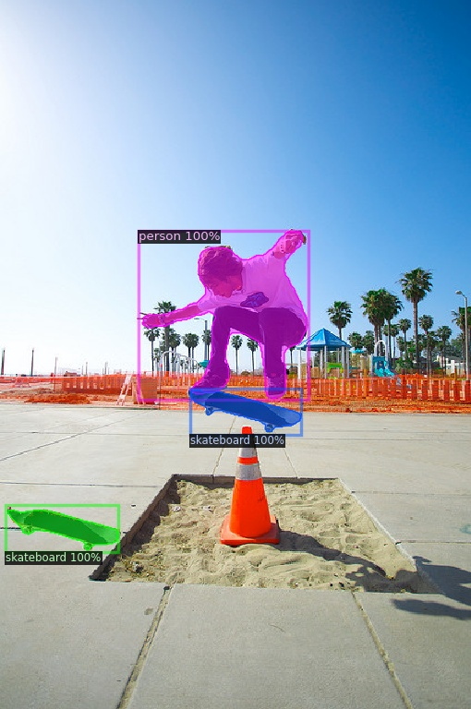
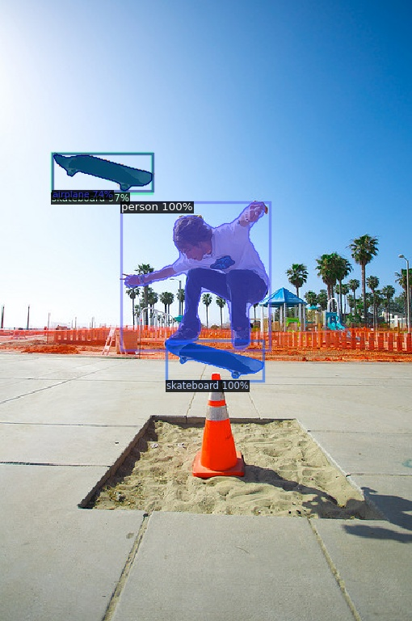
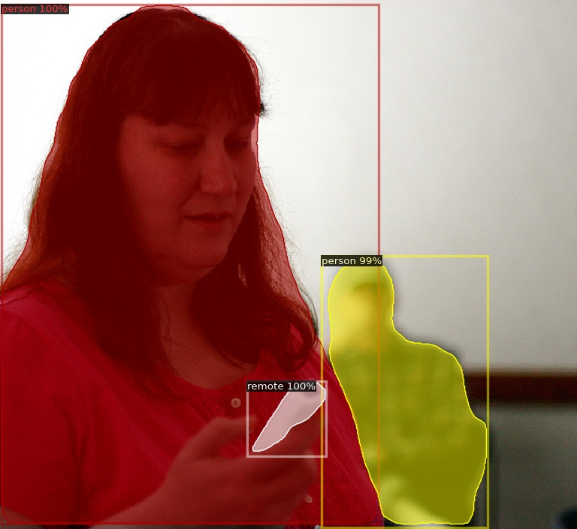
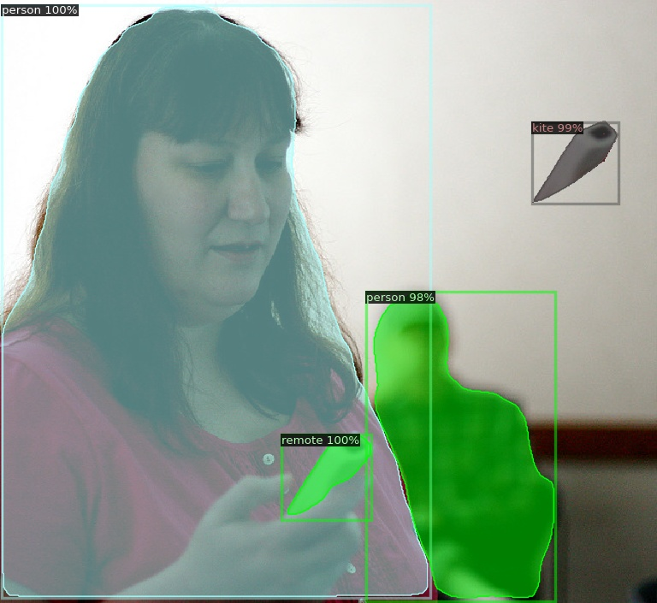
Task (c): Background matters: floor & sky/wall
Skateboard
No detection
Airplane
Additionally, if the object is duplicated in a location with a different background, the model may not be able to generalize well, leading to misclassifications
Skateboard
Good
Airplane
Original
Airplane

Slide 24
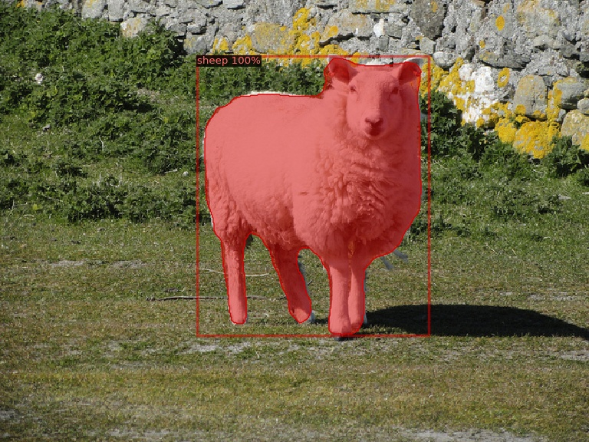
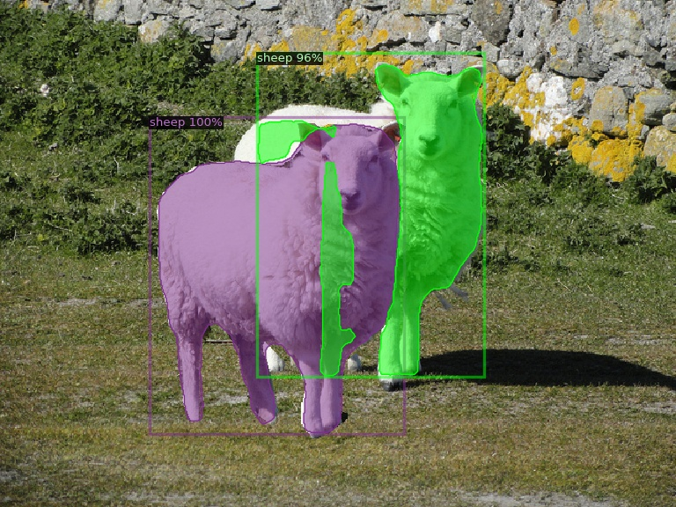
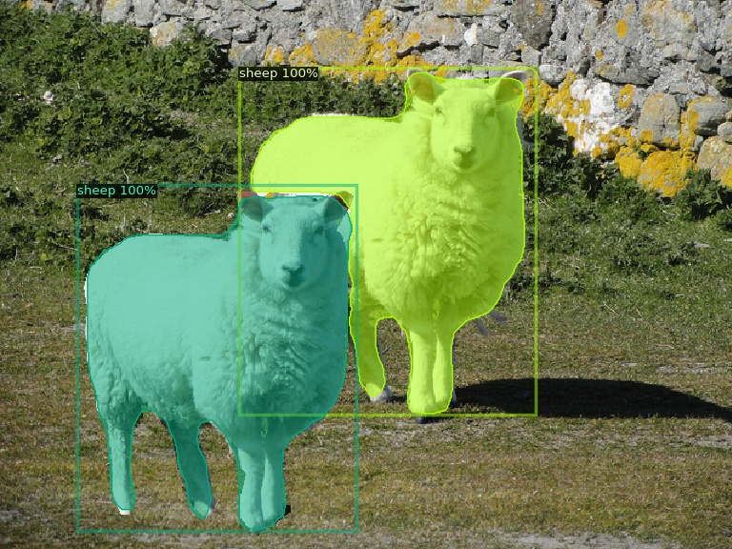
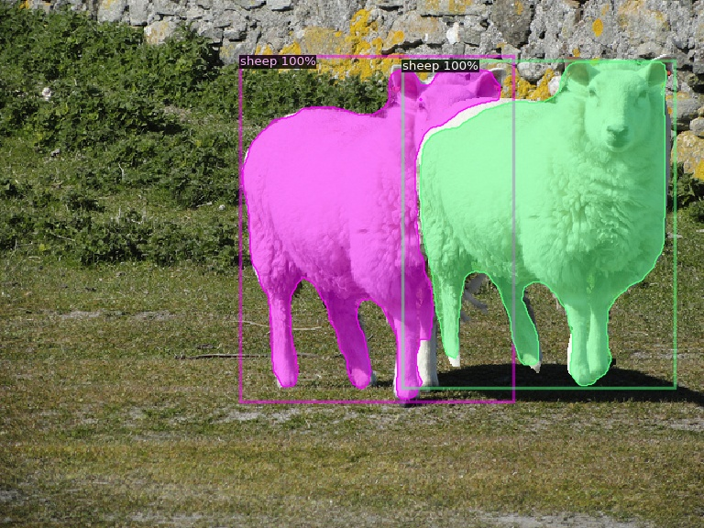
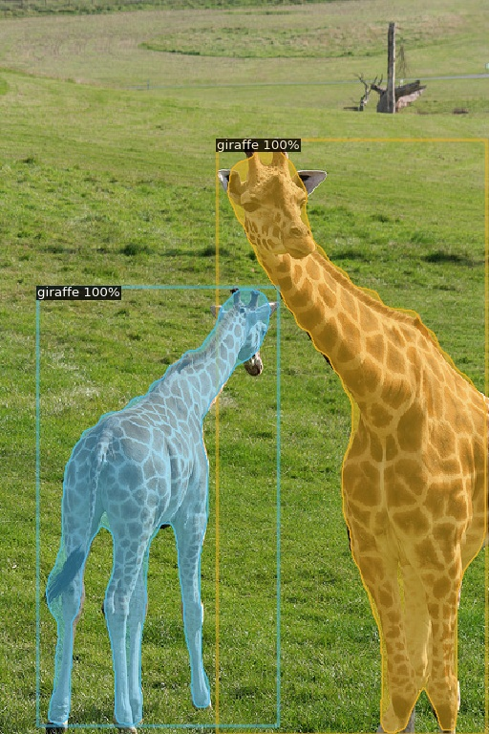
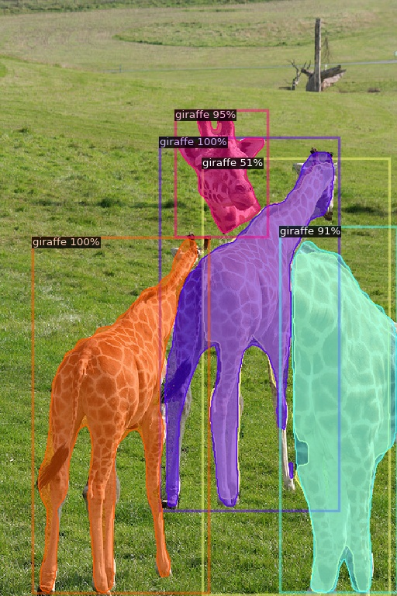
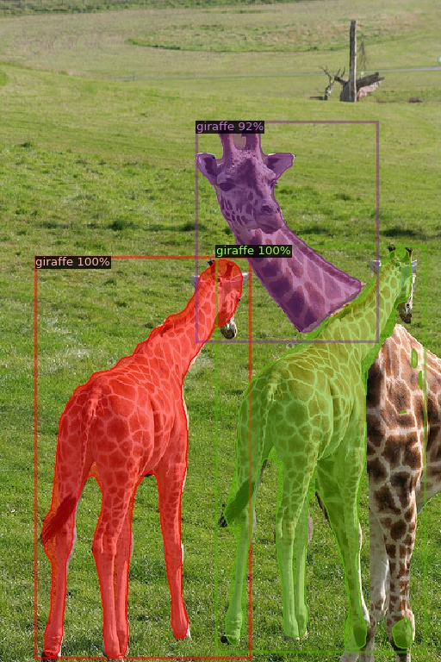
Task (c): Overlaps
Sheep
Bad masking
Good
Good
Object overlaps can make it difficult for models to differentiate between objects, leading to errors in detection and masking. Several factors can affect object detection in overlapping images, such as colors, textures, degree of overlap, and object shapes.
In the case of sheep images, the homogeneity of colors might make it easier for the model to distinguish between overlapping sheep. However, giraffes with complex patterns can be more challenging to separate.
If overlapping objects are tightly intertwined, it can be difficult for the model to distinguish them. Disconnections in the shape of the objects, created by overlapping areas, can also make it harder for the model to identify them correctly, as in the case of the giraffes.
Bad counting
Bad masking
Giraffe

Slide 25
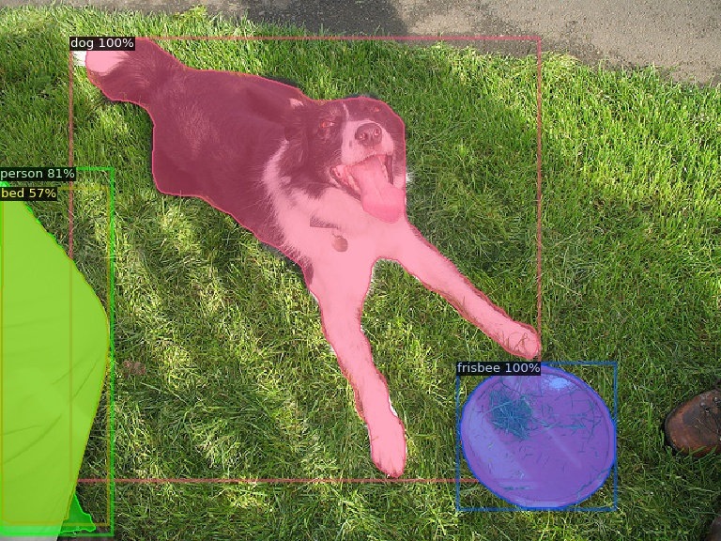
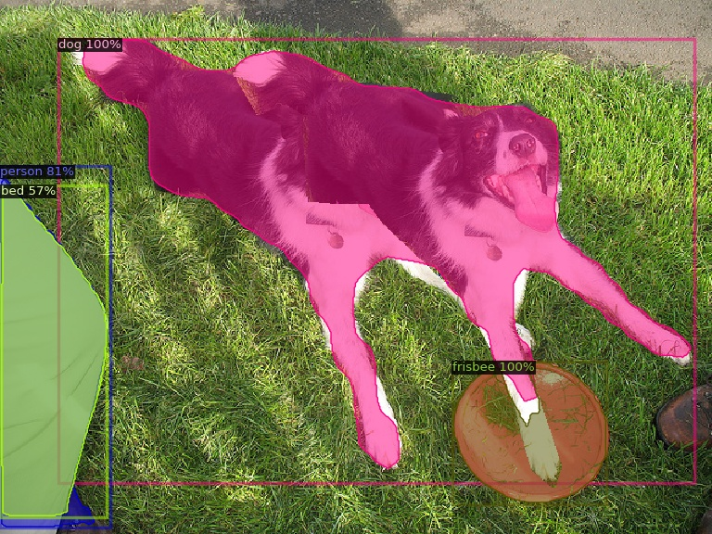
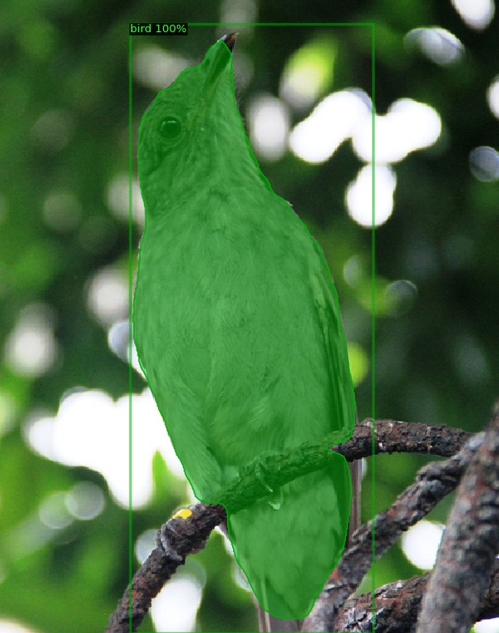
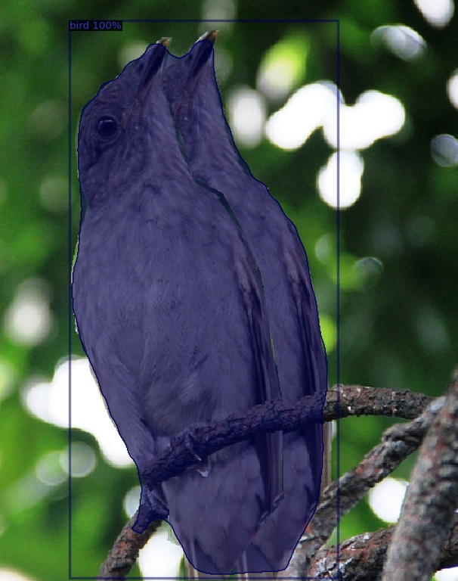


Task (c): Overlaps
Dog
No distinction
If the duplicated object is too close to the original, it might not be detected at all, or the model may count it as part of the original object.
This is because the model cannot identify the boundaries of the objects, making it difficult to distinguish between the two
Bird
No distinction
No distinction
Good

Slide 26






Task (c): Partial occlusions
Cat
Good
Good
Occlusions occur when an object in an image is partially blocked or obscured by another object. This can make it challenging for the model to detect and classify the object correctly because some of its features are obscured.
When the partially occluded object is duplicated, the model might still be able to detect the object, but its accuracy might be lower because some of the object's features are still obscured. In some cases, the model might misclassify the duplicated object if it is distorted or partially visible due to the occlusion.
Tennis racket
Tennis racket & frisbee
frisbee & frisbee
In the cat image, the model performs good since the occluded area is not significant.
In the other hand, it’s challenging for the model to classify the round & handle part of the tennis racket.

Slide 27





Task (c): “Crowded” pictures
Object detection models can perform well in crowded images as long as the objects are distinguishable from each other. This is because the model can use the spatial arrangement of the objects to differentiate between them.
However, if the objects are too close to each other or overlap, the model might have difficulty accurately detecting and classifying them.
Vase
Medium
occlusion
Bird
Good
Bad

Slide 28



Task (c): Improvings
When you duplicate an object in an image, it can provide additional information that can help the model detect and classify the object more accurately.
For example, if the model misses an object in the original image, duplicating the object might help the model to recognize the object because it provides additional instances of the object for the model to learn from.
Additionally, if the duplicated object is in a different location or under different lighting conditions than the original object, it can help the model to generalize better to those conditions.
No bag detection
Bag detection

Slide 29
Task (c): Summary
The background of an image plays a crucial role in object detection accuracy, and similar backgrounds can confuse the model.
Overlapping objects can cause the model to count them as a single instance, and partially occluded objects can be difficult for the model to detect.
Crowded images are manageable as long as the objects are distinguishable, but small or overlapping objects can be missed.
Duplicating objects in an image can provide additional information that can help the model detect and classify objects more accurately, especially if the duplicated object is in a different location or under different lighting conditions than the original object.

Slide 30
Task d: Detection in MSCOCO Dataset by Feature interference using Mask RCNN

Slide 31

Task (d): Detection in MSCOCO Dataset by Feature interference.
In this task we will evaluate the effect of feature interference using Mask RCNN network.
To do so, we will analyze the following cases like in [1] :
Original image with the detections
Setting the outside of the bounding box to black
Setting the outside of the mask to black
Setting the outside of the mask to black and the outside of the bounding box to random noise
[1] Rosenfeld, A., Zemel, R., & Tsotsos, J. K. (2018). The Elephant in the Room. arXiv preprint arXiv:1808.03305.

Slide 32




Task (d): No feature inference
In the majority of cases Mask RCNN
detects the objects without problems, achieving really good results of detection and segmentation.
The surrounding of the object seems not to affect.

Slide 33








Task (d): No feature inference

Slide 34




Task (d): Context is necessary in some cases
In some cases the context seems to be essential to determine the class of the object.
Here we see how when we have all the surrounding or just a little part of it (inside the bounding box), the object is classified correctly as a boat.
However, when there is no context, the boat is not even detected.

Slide 35








Task (d): Context is necessary in some cases

Slide 36




Task (d): Context is essential in some cases
Here we see how we need all the context to correctly classify the animal as a bear.
In this case, only using the content inside the bounding box is not enough.
Note also how depending on the context the animal changes from bear to bird or sheep.

Slide 37




Task (d): Context is essential in some cases
Here we also see how the context seems to be necessary to correctly detect the cat. Without any context, the animal is predicted as a bear and when adding the pixels inside the bounding box it is predicted as a dog.
However, when adding random noise it is also detected as a cat. So, features outside the region of interest interfere with the classification.

Slide 38




Task (d): Random noise
Here we see how adding random noise can affect the accuracy of the detections, confusing the network.
In this case the bird is predicted as a cat when we add random noise. Maybe the network is working worse because it expects a background with less color variance since usually birds are detected with backgrounds of more similar colors like the sky, the sea…

Slide 39




Task (d): Random noise
Similarly, in this case the dog is predicted as a cat when we add random noise.
Here, maybe the network is working worse because it expects a background with less color variance since dogs are usually on the ground.

Slide 40




Task (d): Confusing surroundings
In other cases, the surroundings of the object we want to detect seem to be misleading or useless to detect the right class.
For example, here the bird is only detected correctly if it’s surrounding pixels are set to black.

Slide 41
Task (d): Summary
In many cases, the predictions of the Mask RCNN network seem to be good, even if we remove the context.
However, in some cases we have seen that feature interference can be harmful to the detection process.
Features obtained from pixels that do not belong to the actual object that we want to detect have an effect on the assigned class.
This is true for the pixels inside the bounding box / Region of interest and also for the ones from outside.
When adding random noise we have also shown how the features outside the region of interest can interfere with the predictions.

Slide 42
Task e: Style transfer (optional)

Slide 43

Task (e): Pipeline
In this task we used MASK_RCNN to apply segmentation on the object detection, and we obtain the first classification of the image (Results before style transfer). We use the detection to create an image with the content of the object and a white background like in [1]
Then, we apply style transfer from [2] using pretrained weights from ImageNet using as a style one picture of the COCO dataset and we apply it to previously created picture that has the desired object.
Finally, we do detection and segmentation of the final image created with style transfer
→ Since getting the style form an image of the COCO dataset produced really weird results, we also tried to use one image only with texture, wood in our case, to experiment better with textures.
[1]

Slide 44



Task (e): Style transfer on a cat
PreDetection
Style
PostDetection
In this case, even the weird style transferred, the cat is still detected as a cat. However, note that the confidence is a little bit lower.

Slide 45



Task (e): Style transfer on a bottle
PreDetection
Style
PostDetection
Here we also see that the detection is still good, but confidence decreases

Slide 46



Task (e): Style transfer on a cup
PreDetection
Style
PostDetection
In this case we used specifically a texture, instead of a picture from the COCO dataset.
Here we see how the cup becomes a bottle after style transfer. We also see how the confidence drops.

Slide 47


Task (e): Summary
Style transfer is pretty bad depending on the style because datasets don’t have good texture images.
Sometimes object after applying Style Transfer it’s impossible to detect the desired object or it is detected as another thing.
In some cases contours are not at all uniform with the style transfer.
Bad Case
Good Case

Slide 48
Conclusions

Slide 49
Conclusions
.
Object detection with MaskRCNN is generally more robust than with FasterRCNN, especially in cases where object textures and colors are similar to the background or differ from real-world examples.
Duplicating objects in an image can provide additional information and improve object detection accuracy, but overlapping objects and partially occluded objects can still pose challenges for the model.
The background of an image plays a crucial role in object detection accuracy, and similar backgrounds can confuse the model. Crowded images with small or overlapping objects can be missed by the model.
Feature interference can be harmful to the detection process in MaskRCNN. Features obtained from pixels that do not belong to the actual object that we want to detect have an effect on the assigned class, even for pixels outside the region of interest.
Style transfer can impact the detectability of objects, as some styles can result in texture loss and non-uniform contours, making it more difficult for object detection models to correctly identify objects.
Notes:
Task a:
Object detection models such as FasterRCNN and MaskRCNN can struggle with object recognition when textures are similar or when objects are outside their context. FasterRCNN can misclassify objects with similar textures, while MaskRCNN can more accurately detect such objects. However, both models can still correctly detect and label objects outside their context in most cases.
Task b:
When transplanting objects into new images using MaskRCNN, the model is generally able to recognize the transplanted objects, especially for cases such as dogs and clocks. However, in some cases, such as TVs in dark backgrounds, the model may fail to detect the objects. This highlights the importance of background and lighting conditions for object detection.
Task c:
The background of an image plays a critical role in object detection accuracy, and overlapping or partially occluded objects can be challenging for the model. Duplicating objects in an image can provide additional information that can help the model detect and classify objects more accurately, especially if the duplicated object is in a different location or under different lighting conditions than the original object.
Task d:
Feature interference can be harmful to the detection process in MaskRCNN, as features obtained from pixels outside the region of interest can interfere with the predictions. Adding random noise can further amplify this issue. Therefore, it is essential to pay attention to the pixels and features included in the model's training and detection processes.
Task e:
Style transfer can impact object detectability, as some styles may result in texture loss and non-uniform contours, making it more difficult for object detection models to identify objects. It is important to choose styles that preserve object details and contours to minimize the impact on object detection accuracy.

